Slide 1


Java Functions and Methods

Slide 2
What We’ll Be Talking About
Go Lab
Functions vs. Methods
Java Functions
Example

Slide 3

Let’s hop in live share.

Slide 4
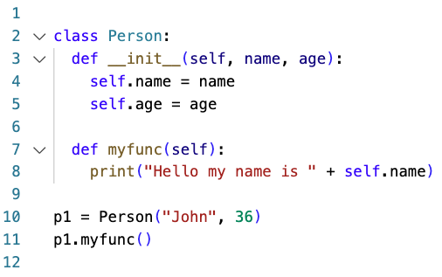
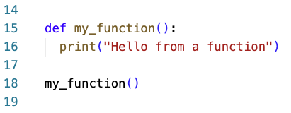
Functions vs. Methods
In python the distinction between methods and functions was relatively easy to make.

Slide 5
Functions vs. Methods
But in Java everything must be inside a class. So, the distinctions is a little harder to make.
People will often simply say that Java only has methods, which in a sense is true.
However, if you define a method as:
A function that “belongs to” an object.
Then you can, in a way, have methods and functions both.

Slide 6
Static Keyword
The keyword “static” in Java is used to declare variables, methods, blocks, and nested classes.
It’s what’s known as a non-access modifier.
It modifies the variable but doesn’t affect access.
Access Modifiers are things like: Public, Private, Protected
When a variable is declared as static, it belongs to the class, rather than to an instance of the class.
This means that only one instance of a static variable exists, even if you create multiple objects of the class, or if you don't create any. It will be shared by all objects.

Slide 7
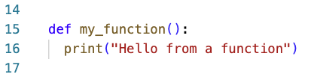
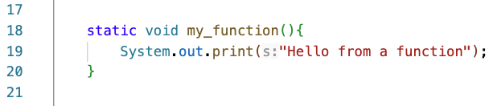
Functions vs. Methods
So, in Java, I would say that there are static functions and non-static methods.

Slide 8
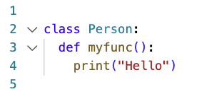
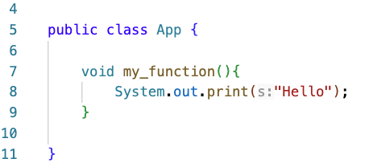
Functions vs. Methods
So, in Java, I would say that there are static functions and non-static methods.

Slide 9
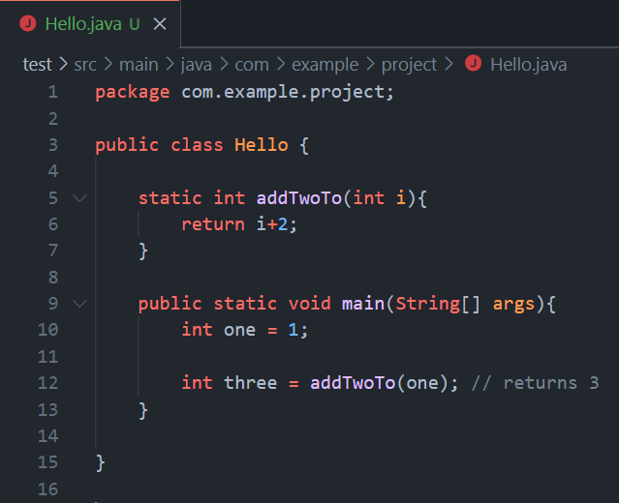
Functions / Methods
Needs to be accessible, for example using static if you mean to use it within the class.

Slide 10
Functions / Methods
Needs to be accessible, for example using static if you mean to use it within the class.
Can take arguments.

Slide 11
Functions / Methods
Needs to be accessible, for example using static if you mean to use it within the class.
Can take arguments.
Must have a return type, which could be void.

Slide 12
Functions / Methods
Needs to be accessible, for example using static if you mean to use it within the class.
Can take arguments.
Must have a return type, which could be void.
If a return type, besides void, is specified it must return that type every time.

Slide 13
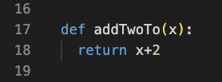

Slide 14

Anonymous Functions
In Java, like python, there are anonymous functions.
In python you may have also called them lambda functions.
We will be learning this later on.

Slide 15

Nested Functions
In Java, like in python, there are also ways to nest functions.
But this is also quite tricky, and we will learn this later on.

Slide 16
Closing
Please Read: The rest of Chapter 1
Office Hours In SS-411:
Tu & Th 2pm – 3pm
Mon & Wed 10am–11am
Have a great weekend and I’ll see you on Wednesday!

